Slide 1


CS50 SQL Final Project: PCSHOP
Iulian Ionel Bocșe

Slide 2


iulian-b
b_iulian
29/12/2023
Bucharest, RO

Slide 3
TABLES
CPUs | Processors and their specifications
GPUs | Graphics cards and their specifications
PSUs | Power supply units and their specifications
MOBOs | Motherboards and their specifications
Computers | Computers, details about them and the components that they’re made of
Customers | Customer identification
Orders | Order details
Order Items | Rows present in Orders table

Slide 4
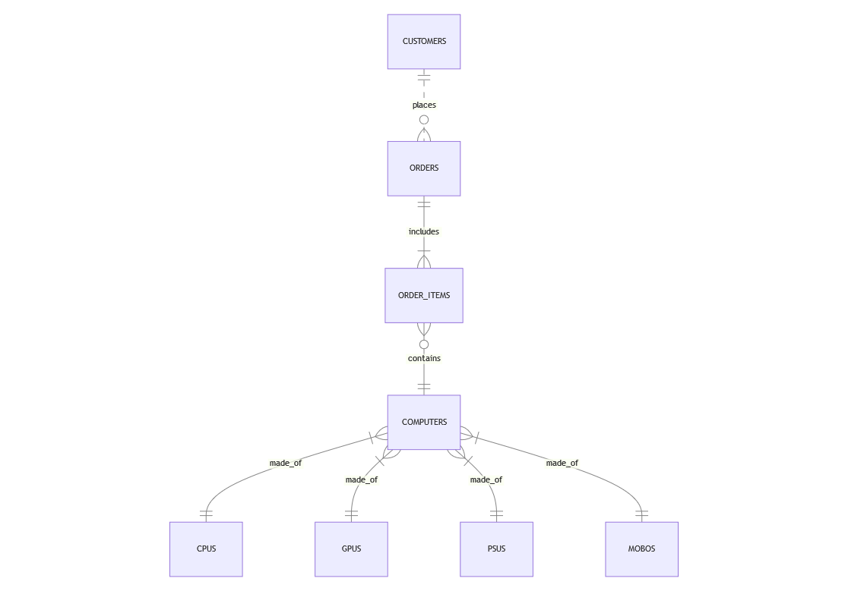
E:R DIAGRAM

Slide 5
Thank you!
iulian@firemail.cc iulibocse@gmail.com
iulian-b
b_iulian
Please keep this slide for attribution

